Slide 1
Centroids
Principles of Engineering

Slide 2
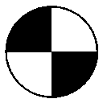
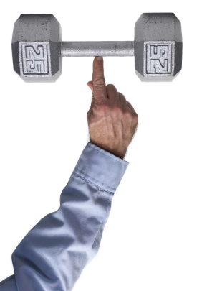

Centroid Principles
Object’s center of gravity or center of mass
Graphically labeled as

Slide 3

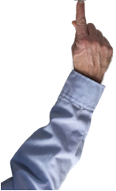
Centroid Principles
Point of applied force caused by acceleration due to gravity
Object is in state of equilibrium if balanced along its centroid

Slide 4
Centroid Principles
What is an object’s centroid location used for in statics?
Theoretical calculations regarding the interaction of forces and members are derived from the centroid location.

Slide 5
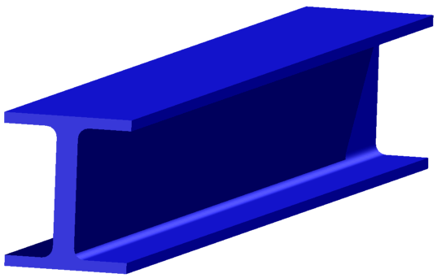
Centroid Principles
One can determine a centroid location by utilizing the cross-section view of a three-dimensional object.

Slide 6

Centroid Location
Symmetrical Objects
Centroid location is determined by an object’s line of symmetry.
Centroid is located on the line of symmetry.
When an object has multiple lines of symmetry, its centroid is located at the intersection of the lines of symmetry.

Slide 7



Centroid Location
The centroid of a square or rectangle is located at a distance of 1/2 its height and 1/2 its base.
H
B

Slide 8


Centroid Location
The centroid of a right triangle is located at a distance of 1/3 its height and 1/3 its base.
H
B
Notes:
Since a triangle does not have an axis of symmetry, the location of its centroid must be calculated.
First, calculate the area of the triangle.
The x component of the centroid, lower case x bar, is the length of the base divided by 3. The y component of the centroid, lower case y bar, is the length of the height divided by 3. In other words, the centroid is located one-third of the distance from the large end of the triangle (or two-thirds of the distance from the pointed end).

Slide 9

Centroid Location
The centroid of a ½ circle or semi-circle is located at a distance of away from the axis on its line of symmetry
.849in.

Slide 10
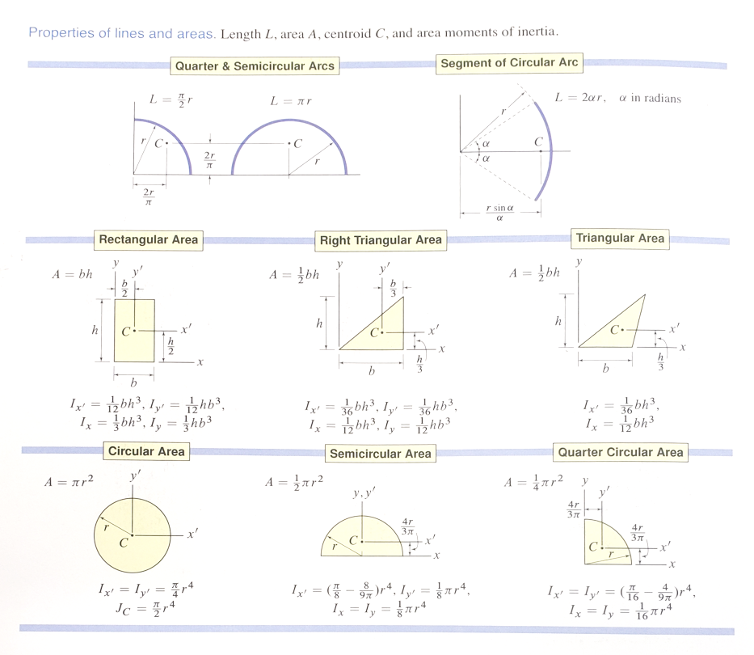

Slide 11
Centroid Location Equations Complex Shapes

Slide 12

Centroid Location Complex Shapes
2
1
3
1. Divide the shape into simple shapes.
2. Determine a reference axis.

Slide 13
Centroid Location Complex Shapes
Review: Calculating area of simple shapes
Area of a square =
Area of a rectangle =
Side²
Width * Height
Area of a triangle =
Area of
a circle =
πr²
½ (base)(height)

Slide 14
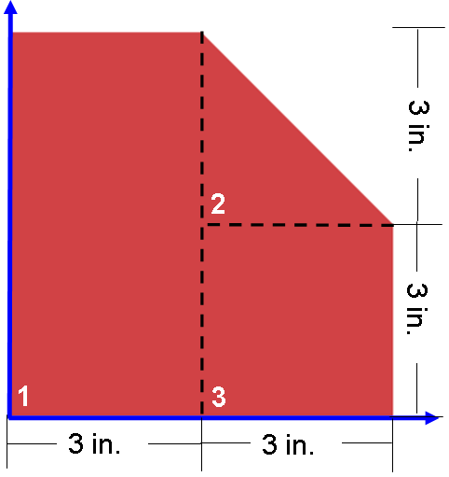
Centroid Location Complex Shapes
3. Calculate the area of each simple shape.
Assume measurements have 3 digits.
Area of shape #1 =
Area of shape #2 =
Area of shape #3 =
width x height
3.00in. x 6.00in. = 18.0in.²
4.5in.²
18in.²
2
½ base x height
9in.²
½x3.00in.x3.00in. = 4.50in.²
side²
(3.00in.)² = 9.00in.²

Slide 15
Centroid Location Complex Shapes
4. Determine the centroid of each simple shape.
Shape #1 Centroid Location
Shape #2 Centroid Location
Shape #3 Centroid Location
Centroid is located at the intersection of the lines of symmetry.
1/3 h
1/3 b
Centroid is located at the intersection of 1/3 its height and 1/3 its base.
Centroid is located at the intersection of the lines of symmetry.

Slide 16
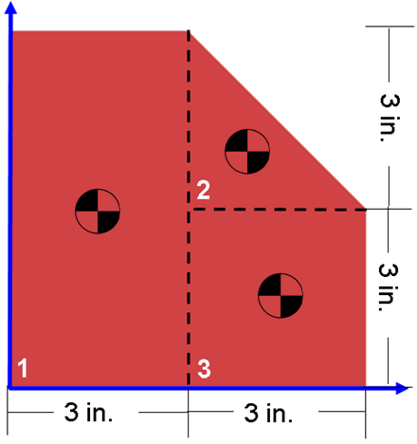
Centroid Location Complex Shapes
5. Determine the distance from each simple shape’s centroid to the reference axis (x and y).
4in.
1.5in.
4in.
4.5in.
3in.
1.5in.

Slide 17
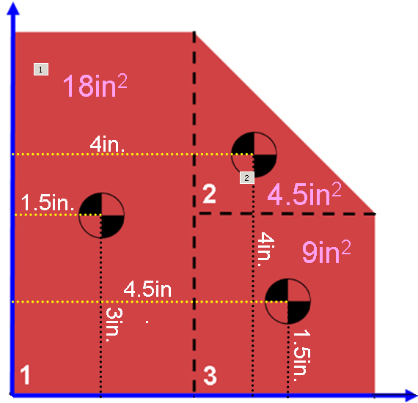
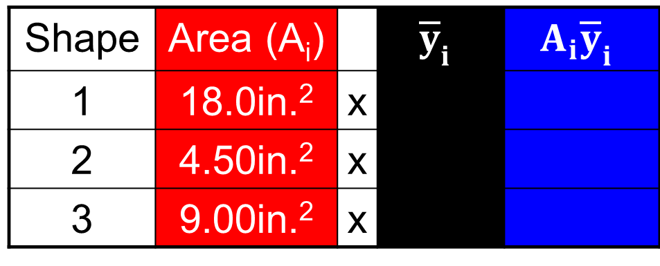
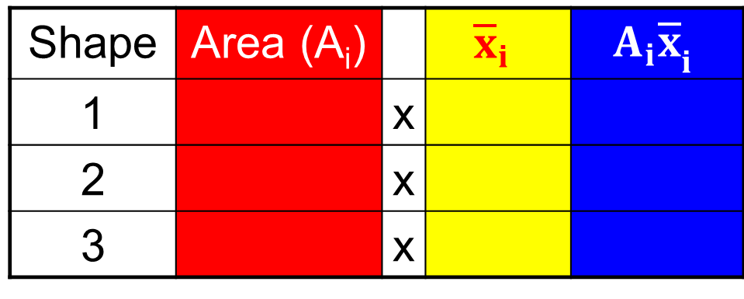
Centroid Location Complex Shapes
6. Multiply each simple shape’s area by its distance from centroid to reference axis.
Shape | Area (A_{i}) |  | $${\overline{x}}_{i}$$ | $${A_{i}\overline{x}}_{i}$$
1 |  | x
2 |  | x
3 |  | x
18.0in.²
1.50in.
27.0in.³
4.50in.²
4.00in.
18.0in.³
9.00in.²
4.50in.
40.5in.³
Shape | Area (A_{i}) |  | $${\overline{y}}_{i}$$ | $${A_{i}\overline{y}}_{i}$$
1 | 18.0in.² | x
2 | 4.50in.² | x
3 | 9.00in.² | x
3.00in.
54.0in.³
4.00in.
18.0in.³
1.50in.
13.5in.³

Slide 18
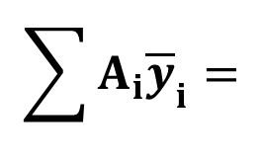
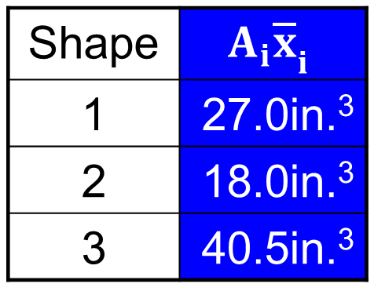
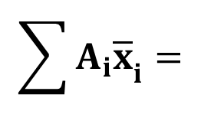
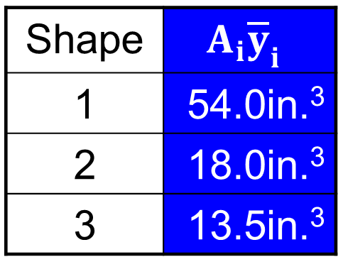
Centroid Location Complex Shapes
7. Sum the products of each simple shape’s area and their distances from the centroid to the reference axis.
$$\sum{{A_{i}\overline{x}}_{i}=}$$
Shape | $${A_{i}\overline{x}}_{i}$$
1 | 27.0in.³
2 | 18.0in.³
3 | 40.5in.³
85.5in.³
$$\sum{{A_{i}\overline{y}}_{i}=}$$
Shape | $${A_{i}\overline{y}}_{i}$$
1 | 54.0in.³
2 | 18.0in.³
3 | 13.5in.³
85.5in.³

Slide 19
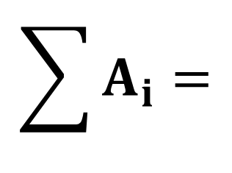
Centroid Location Complex Shapes
8. Sum the individual simple shape’s area to determine total shape area.
Shape | A_{i}
1 | 18in.²
2 | 4.5in.²
3 | 9in.²
$$\sum{A_{i}=}$$
4.5in.²
31.5in.²
18in.²
9in.²

Slide 20
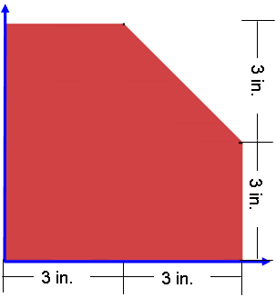
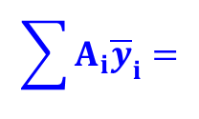
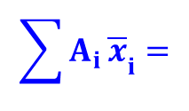
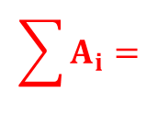
Centroid Location Complex Shapes
9. Divide the summed product of areas and distances by the summed object total area.
$$\sum{{A_{i }\overline{x}}_{i}=}$$
85.5in.³
2.7in.
$$\sum{{A_{i}\overline{y}}_{i}=}$$
85.5in.³
$$\sum{A_{i}=}$$
31.5in.²
2.71in.
2.7in.
2.71in.
Does this shape have any lines of symmetry?

Slide 21
Alternative Solution
The same problem solved a different way
Previous method added smaller, more manageable areas to make a more complex part.
Alternative Method = Subtractive Method
Uses the exact same equations
Uses nearly the exact same process
Start with a bigger and simpler shape
Treat shapes that need to be removed as “negative” areas
Notes:
When you use negative areas, essentially you are subtracting those value, when they are entered into the summation.

Slide 22

Centroid Location – Subtractive Method
Determine reference axis and start with an area that is bigger than what is given
Square = Shape 1
Remove an area to get the centroid of the complex shape
Triangle = Shape 2
3 in.
3 in.
6 in.
6 in.

Slide 23
Centroid Location Complex Shapes
3. Calculate the area of each simple shape.
Assume measurements have 3 digits.
Area of shape #1 =
3 in.
width x height
6.0in. x 6.0in. = 36 in.²
3 in.
Area of shape #2 =
6 in.
Note: Since the area is being removed, we are going to call it a negative area.
6 in.
-½ base x height
-½x3.0in.x3.0in. = -4.5 in.²
Notes:
Centroids
Principles of EngineeringTM
Unit 4 – Lesson 4.1 - Statics

Slide 24
Centroid Location Complex Shapes
4. Determine the centroid of each simple shape.
Shape #1 Centroid Location
3 in.
1/3 b
Centroid is located at the intersection of the lines of symmetry.
Middle of the square
1/3 h
3 in.
6 in.
Shape #2 Centroid Location
Centroid is located at the intersection of 1/3 its height and 1/3 its base.
6 in.
Notes:
Centroids
Principles of EngineeringTM
Unit 4 – Lesson 4.1 - Statics

Slide 25
Centroid Location Complex Shapes
5. Determine the distance from each simple shape’s centroid to the reference axis (x and y).
3 in.
5in.
3 in.
6 in.
3in.
5in.
3in.
6 in.
Notes:
Centroids
Principles of EngineeringTM
Unit 4 – Lesson 4.1 - Statics

Slide 26

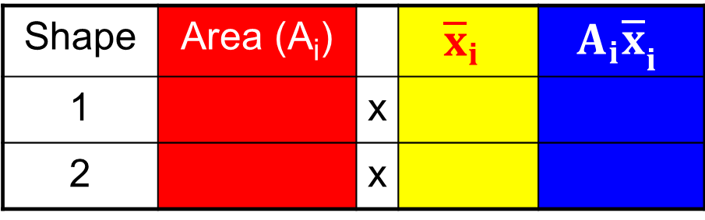
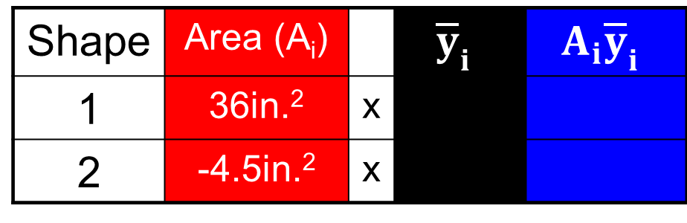
Centroid Location Complex Shapes
6. Multiply each simple shape’s area by its distance from centroid to reference axis.
Shape | Area (A_{i}) |  | $${\overline{x}}_{i}$$ | $${A_{i}\overline{x}}_{i}$$
1 |  | x
2 |  | x
3 in.
36in.²
3.0in.
108in.³
5 in.
-4.5in.²
5.0in.
-22.5in.³
3 in.
3 in.
6 in.
5 in.
Shape | Area (A_{i}) |  | $${\overline{y}}_{i}$$ | $${A_{i}\overline{y}}_{i}$$
1 | 36in.² | x
2 | -4.5in.² | x
3 in.
3.0in.
108in.³
6 in.
5.0in.
-22.5in.³
Notes:
Centroids
Principles of EngineeringTM
Unit 4 – Lesson 4.1 - Statics

Slide 27
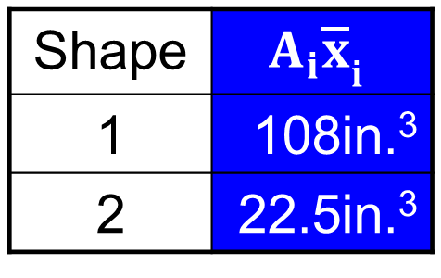
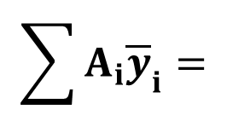
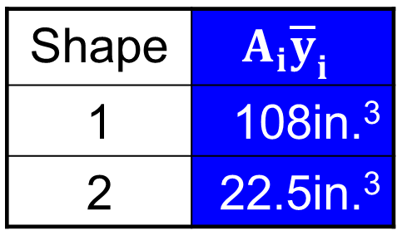
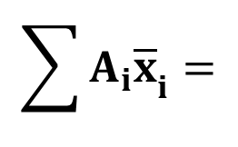
Centroid Location Complex Shapes
7. Sum the products of each simple shape’s area and their distances from the centroid to the reference axis.
$$\sum{{A_{i}\overline{x}}_{i}=}$$
Shape | $${A_{i}\overline{x}}_{i}$$
1 | 108in.³
2 | 22.5in.³
85.5in.³
Shape | $${A_{i}\overline{y}}_{i}$$
1 | 108in.³
2 | 22.5in.³
$$\sum{{A_{i}\overline{y}}_{i}=}$$
85.5in.³
Notes:
Centroids
Principles of EngineeringTM
Unit 4 – Lesson 4.1 - Statics

Slide 28
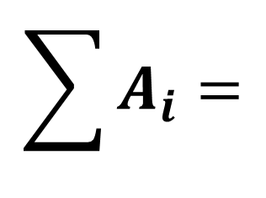
Centroid Location Complex Shapes
8. Sum the individual simple shape’s area to determine total shape area.
Shape | A_{i}
1 | 36 in.²
2 | -4.5 in.²
$$\sum{A_{i}=}$$
3 in.
31.5in.²
3 in.
6 in.
6 in.
Notes:
Centroids
Principles of EngineeringTM
Unit 4 – Lesson 4.1 - Statics

Slide 29
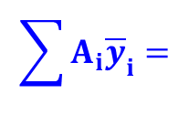
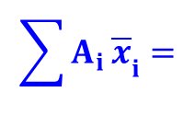
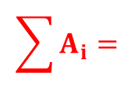
Centroid Location Complex Shapes
9. Divide the summed product of areas and distances by the summed object total area.
$$\sum{{A_{i }\overline{x}}_{i}=}$$
85.5in.³
2.7in.
3 in.
$$\sum{{A_{i}\overline{y}}_{i}=}$$
85.5in.³
$$\sum{A_{i}=}$$
3 in.
31.5in.²
6 in.
2.71in.
2.7in.
6 in.
2.71in.
Does this shape have any lines of symmetry?
Notes:
Centroids
Principles of EngineeringTM
Unit 4 – Lesson 4.1 - Statics

Slide 30
Centroid Location Equations Complex Shapes

Slide 31
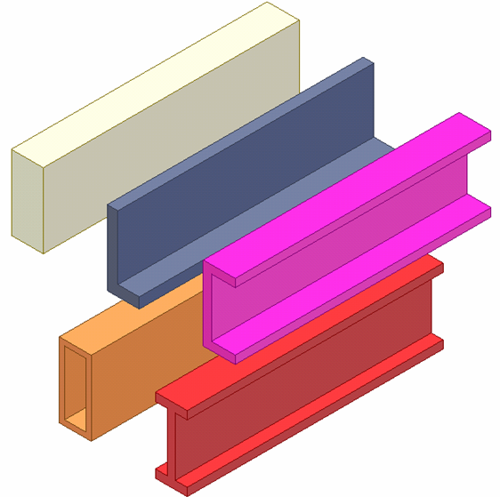
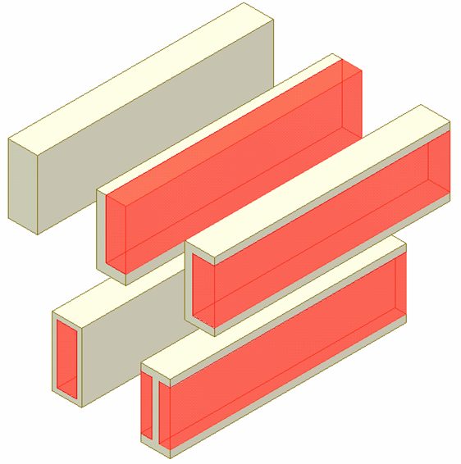
Common Structural Elements
Notes:
Most structural elements have geometry that can be divided into simple shapes. Each of these shapes can be considered to be part of a rectangular solid.
The shapes above include rectangle, L, C, Box, and I.

Slide 32
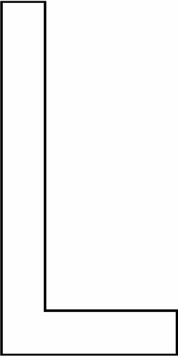
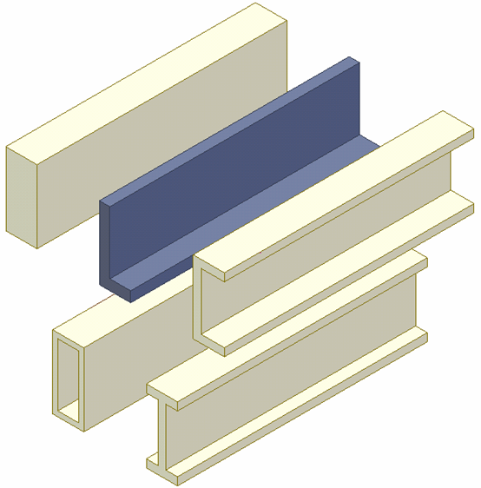
Angle Shape (L-Shape)
Notes:
An angle shape ( L-Shape) can be thought of as being subdivided into two rectangles. This can be done in two different ways.

Slide 33
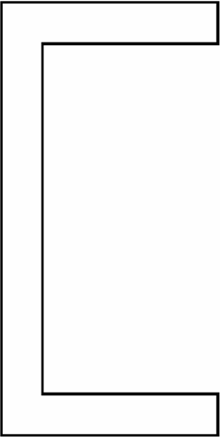
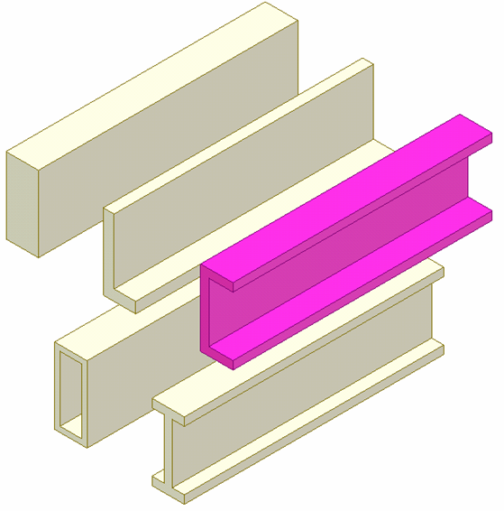
Channel Shape (C-Shape)
Notes:
A channel shape (C-Shape) can be subdivided into 3 rectangles. It can be subdivided in four different ways.

Slide 34
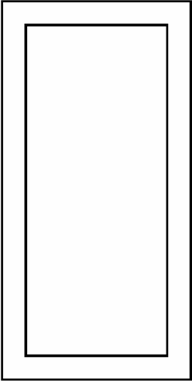
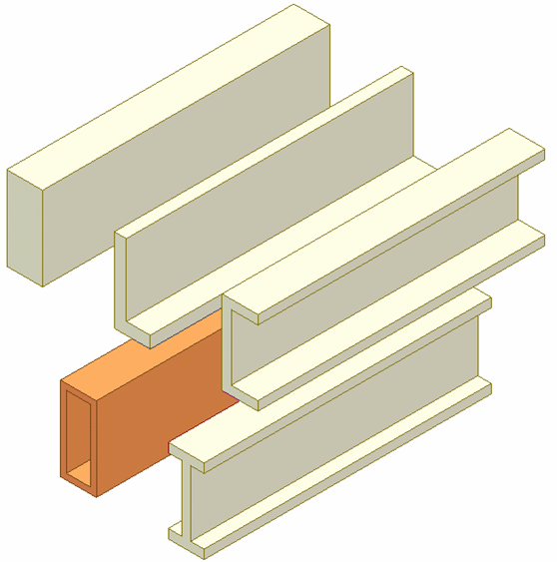
Box Shape
Notes:
The box shape can be divided into four rectangles.

Slide 35
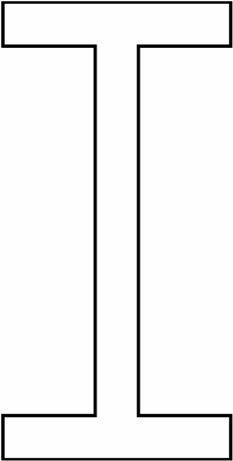
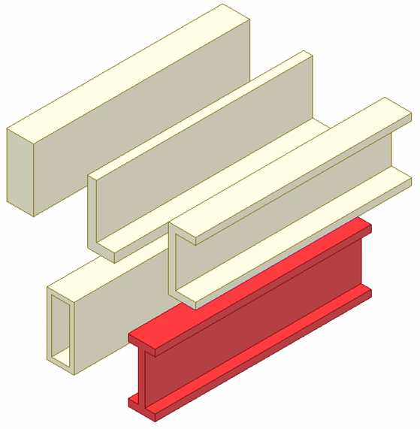
I-Beam
Notes:
An I-Beam can be divided into three rectangles.

Slide 36
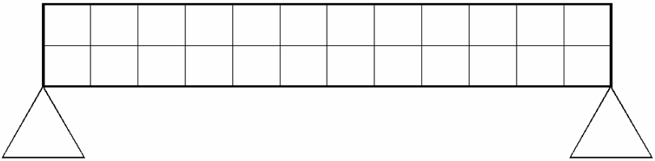
Centroid of Structural Member
Neutral Plane
(Axes of symmetry)
Cross Section View
Notes:
In order to calculate the strength of a structural member, its centroid must first be calculated. If the member is subject to pure bending and its stresses remain in the elastic range, then the neutral axis, when seen in two dimensions, or the neutral plane in 3D, of the member passes through the centroid of the section. The centroid is an ordered pair, an x and y position.
The centroid is always located on an axis of symmetry. For a simple rectangle (which has two axes of symmetry), the location of the centroid is at the intersection of the two axes of symmetry.
Note the symbol used to indicate the centroid.

Slide 37
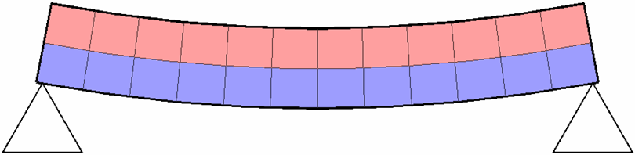
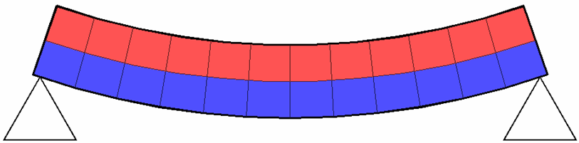
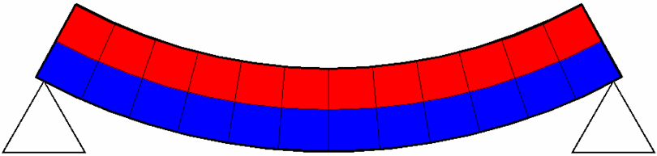
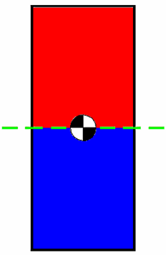
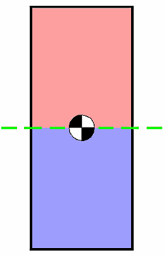
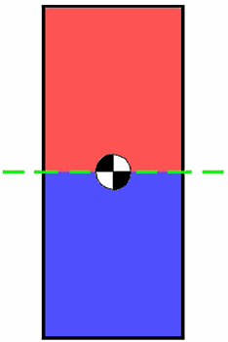
Neutral Plane
Compression
Neutral Plane
(Axes of symmetry)
Tension
Notes:
The neutral plane is the unstressed region that passes through a structural member and separates the section under tension from the part of the structural member under compression.
This can easily be imagined or demonstrated using a loaf of bread that has not been sliced to watch the effects as it undergoes bending.

Slide 38
Moment of Inertia
A measure of an object's resistance to changes to its rotation. • Also defined as the capacity of a cross-section to resist. bending.

Slide 39
Find the Moment of Inertia of a 2x4
1.5 in
3.5 in
3.5 in
1.5 in

Slide 40
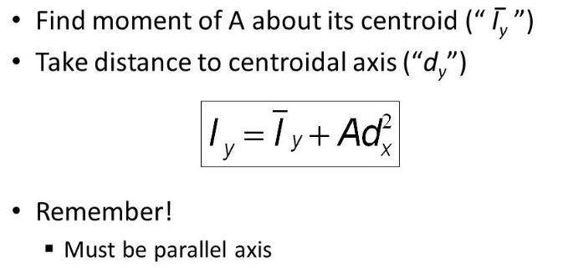
Parallel Axis Theorem

Slide 41
